Slide 1
UX Research Audit
NYPL – undergrad student

Slide 2
Undergrad student:
“USC student, late teens/early 20s. Mobility/time are issues in getting to the Library. Not at the Library as frequently. Not sure about topics for research, less directed than grad students. Often here on class assignment, often in a group. Not so familiar w/ archival research. Comfortable using Internet for searches.
KEY WORDS
Mid education level. High level of comfort with technology. Not familiar w/ library procedures. Not a frequent Library user but potential big user of a Library website with content and functionality that met their needs.”

Slide 3
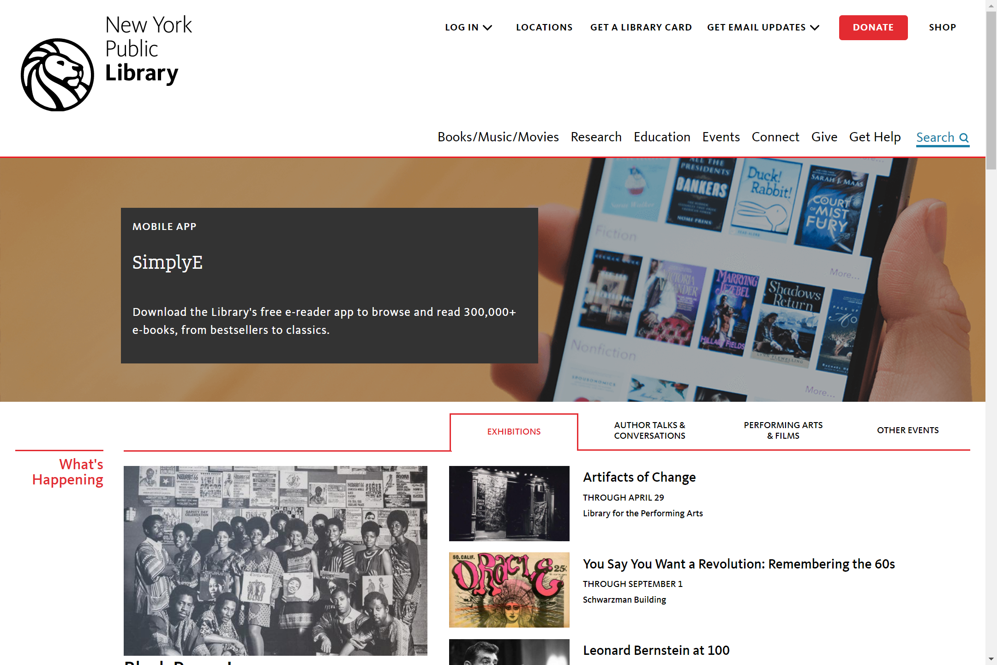
Both research and search seem to work, but research is probably better to click on since it should be for people doing research
These arrows take too long to make

Slide 4
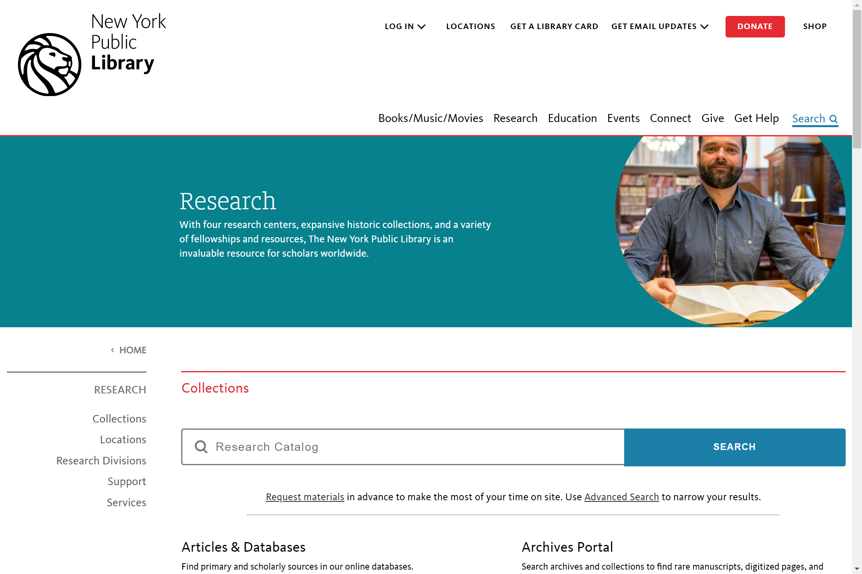
Big search bar looks like it’s the right area to go

Slide 5
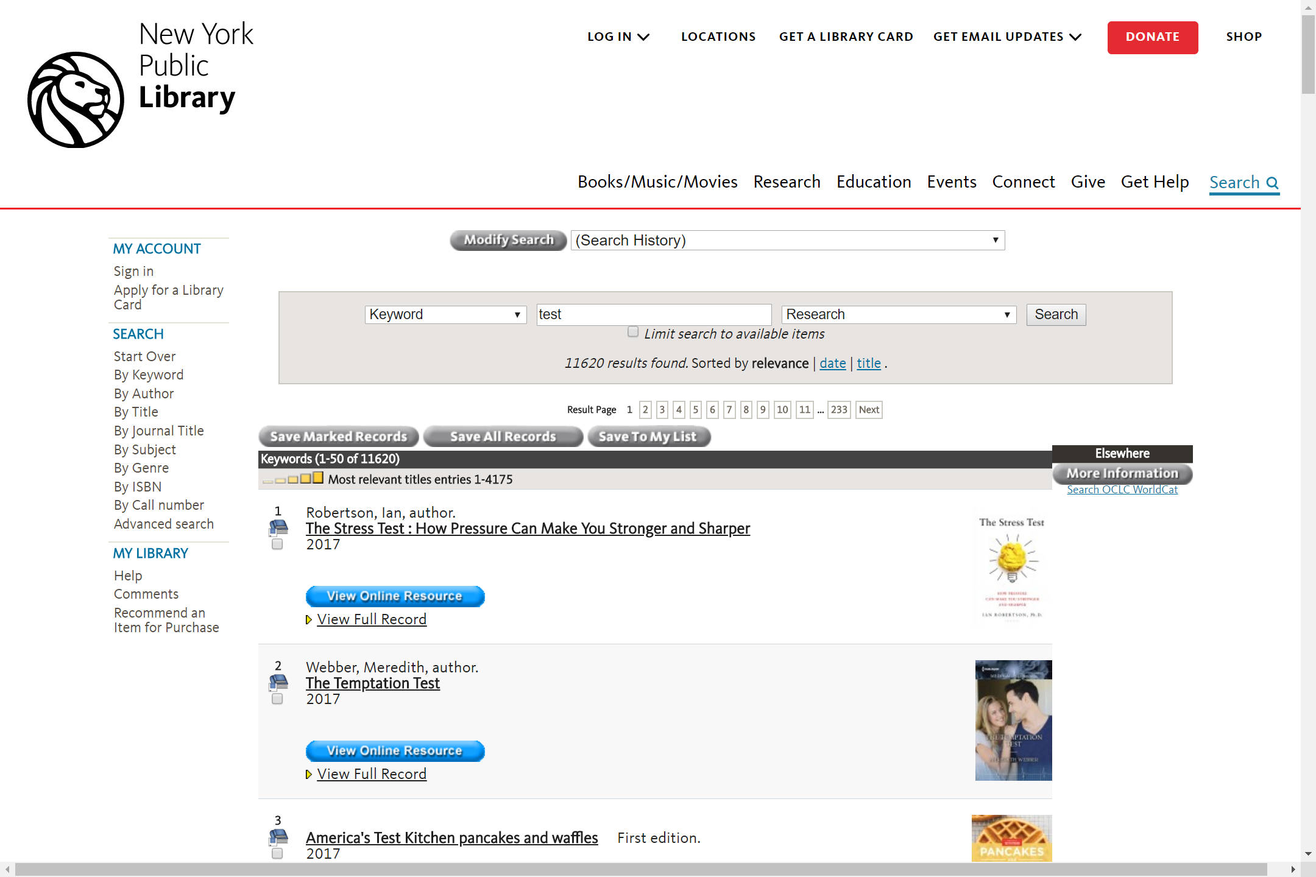
Limit search to available items not that noticeable
Gets these results, kind of hard to see “Advanced search” to the side

Slide 6
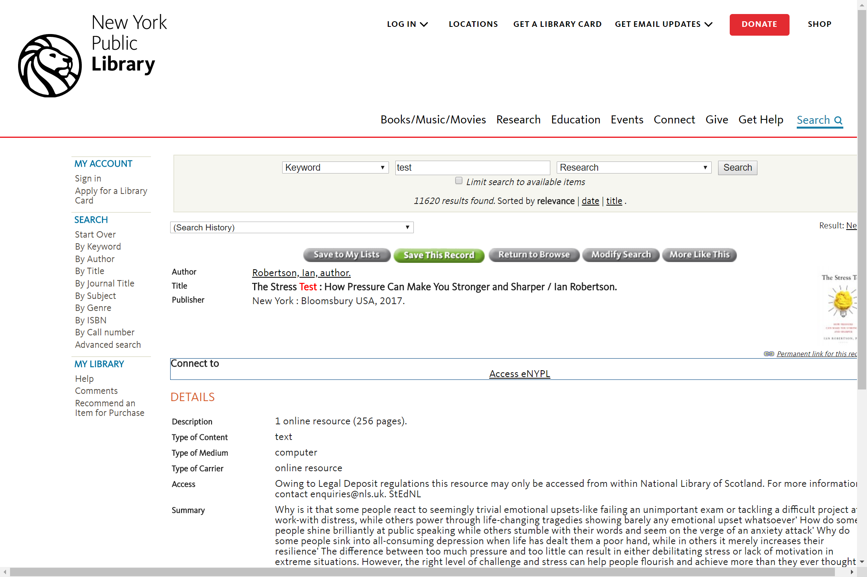
There’s a more like this button to find similar resources
Need to email people to get access to resource

Slide 7
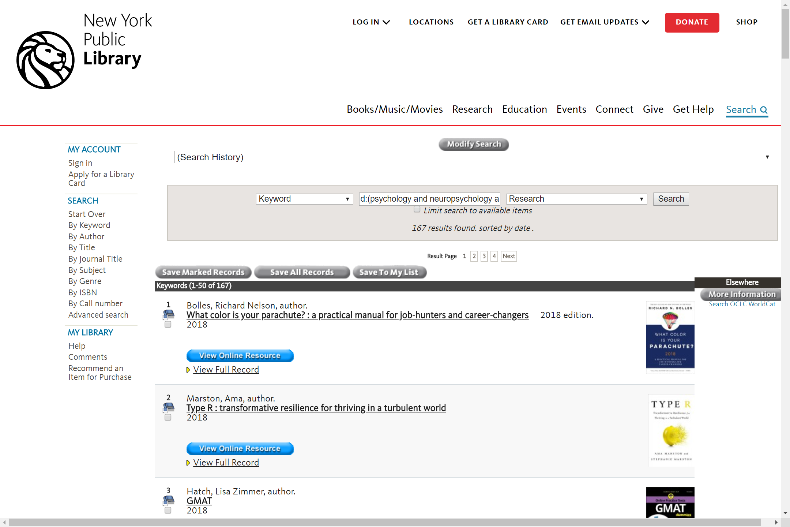
More results

Slide 8
Collections

Slide 9
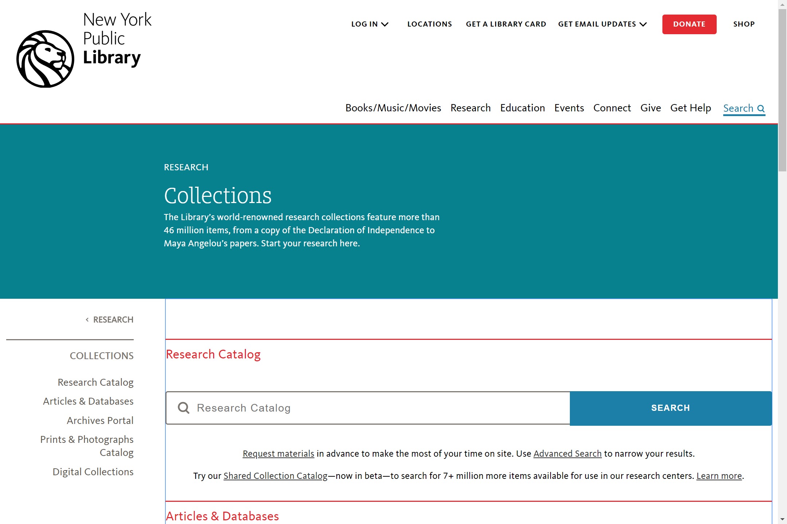
Think research catalog is what I used earlier, click on articles and databases

Slide 10
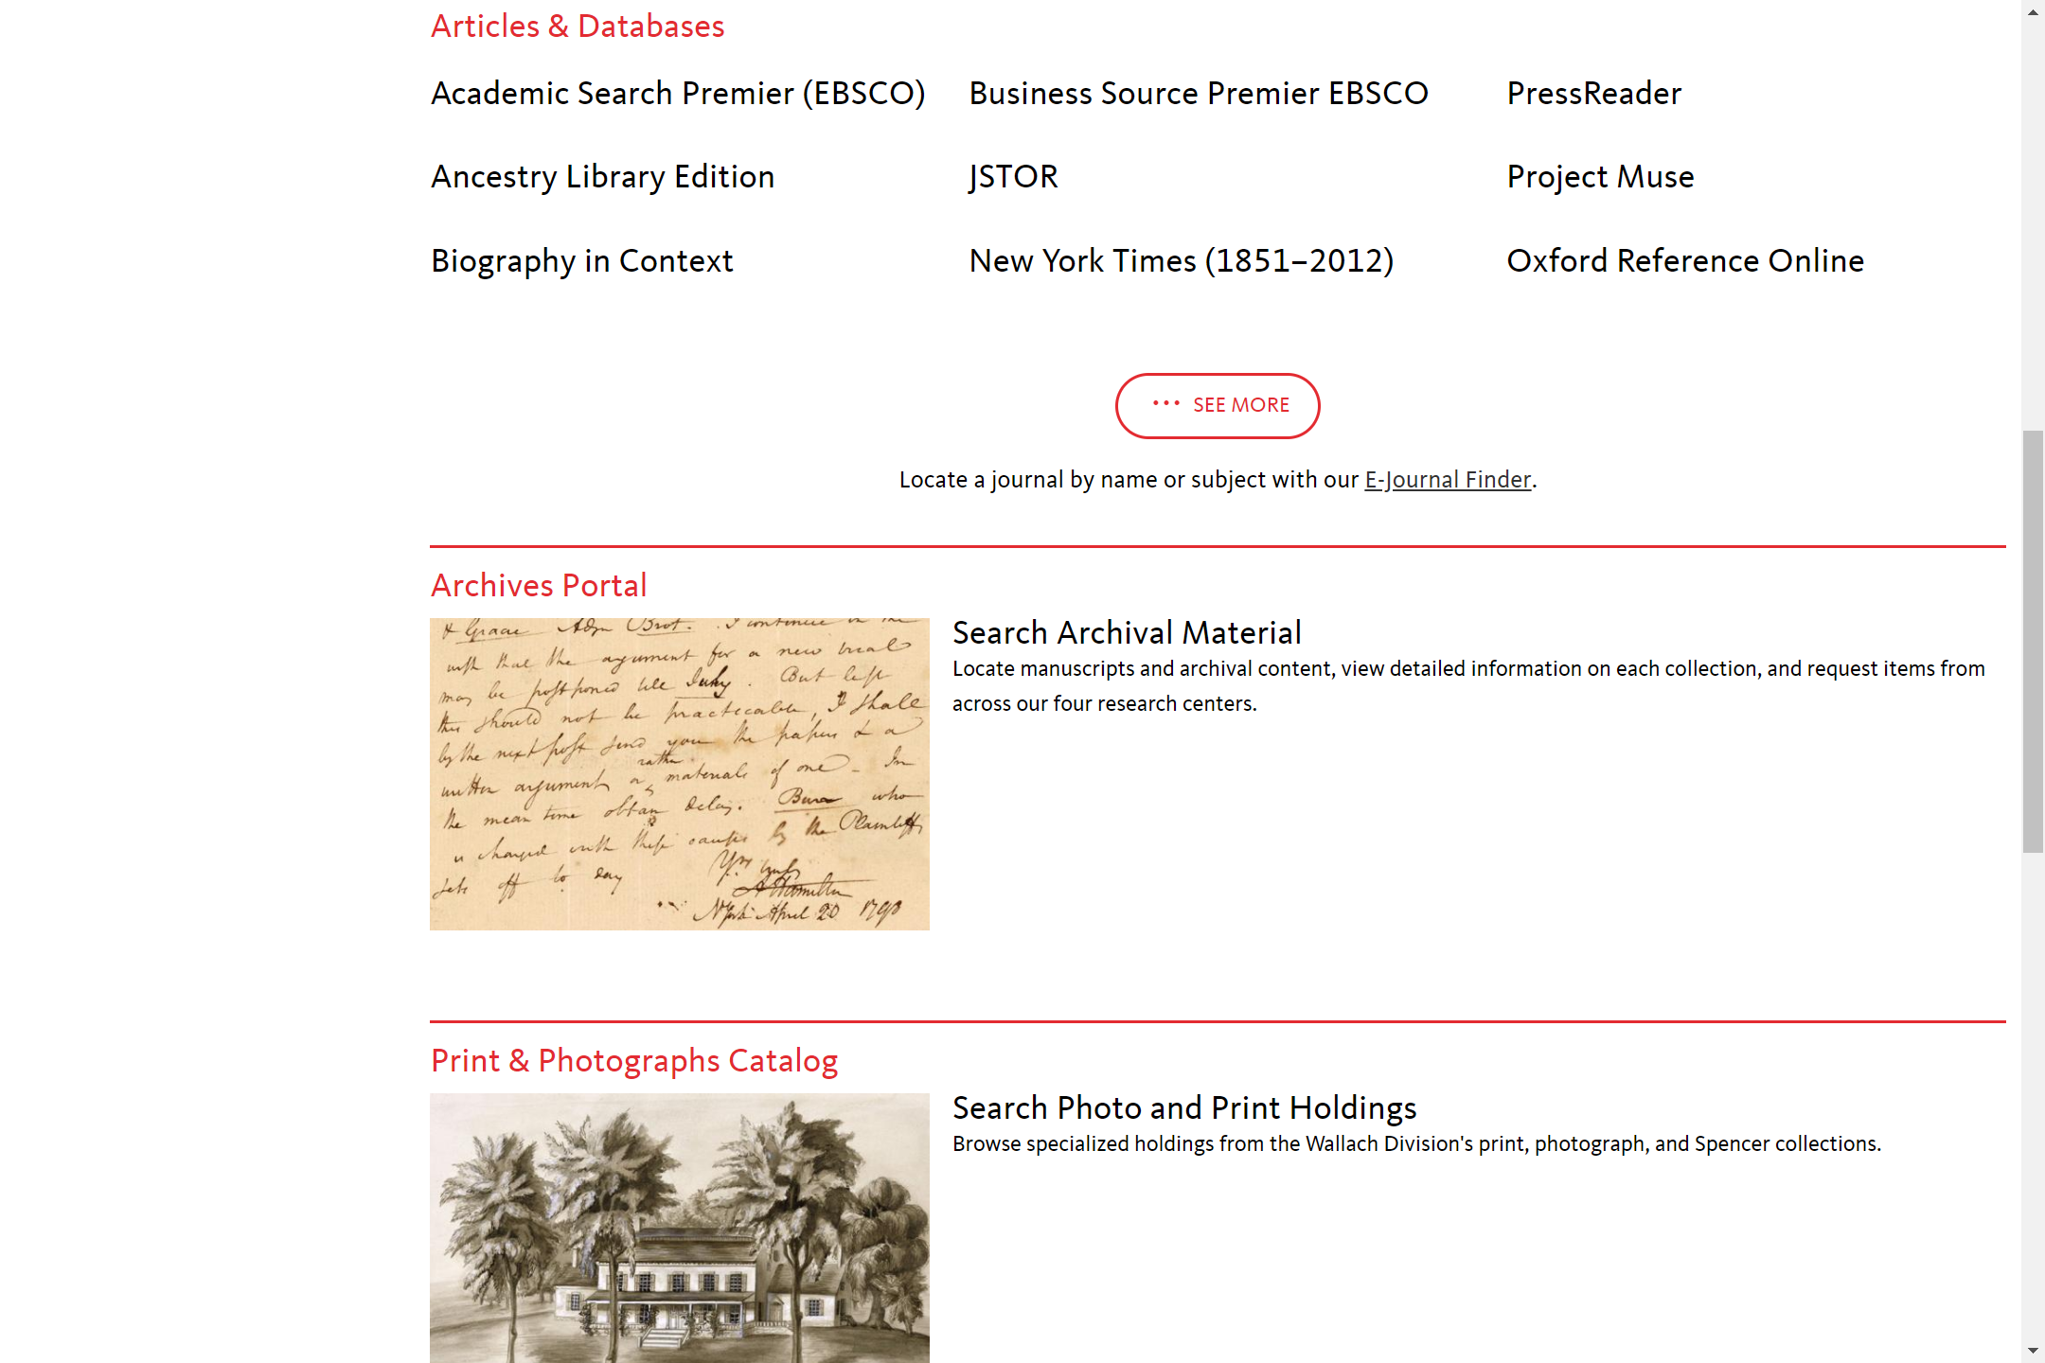
Scrolling down the page, see a bunch of things (databases) listed, not sure what they are

Slide 11
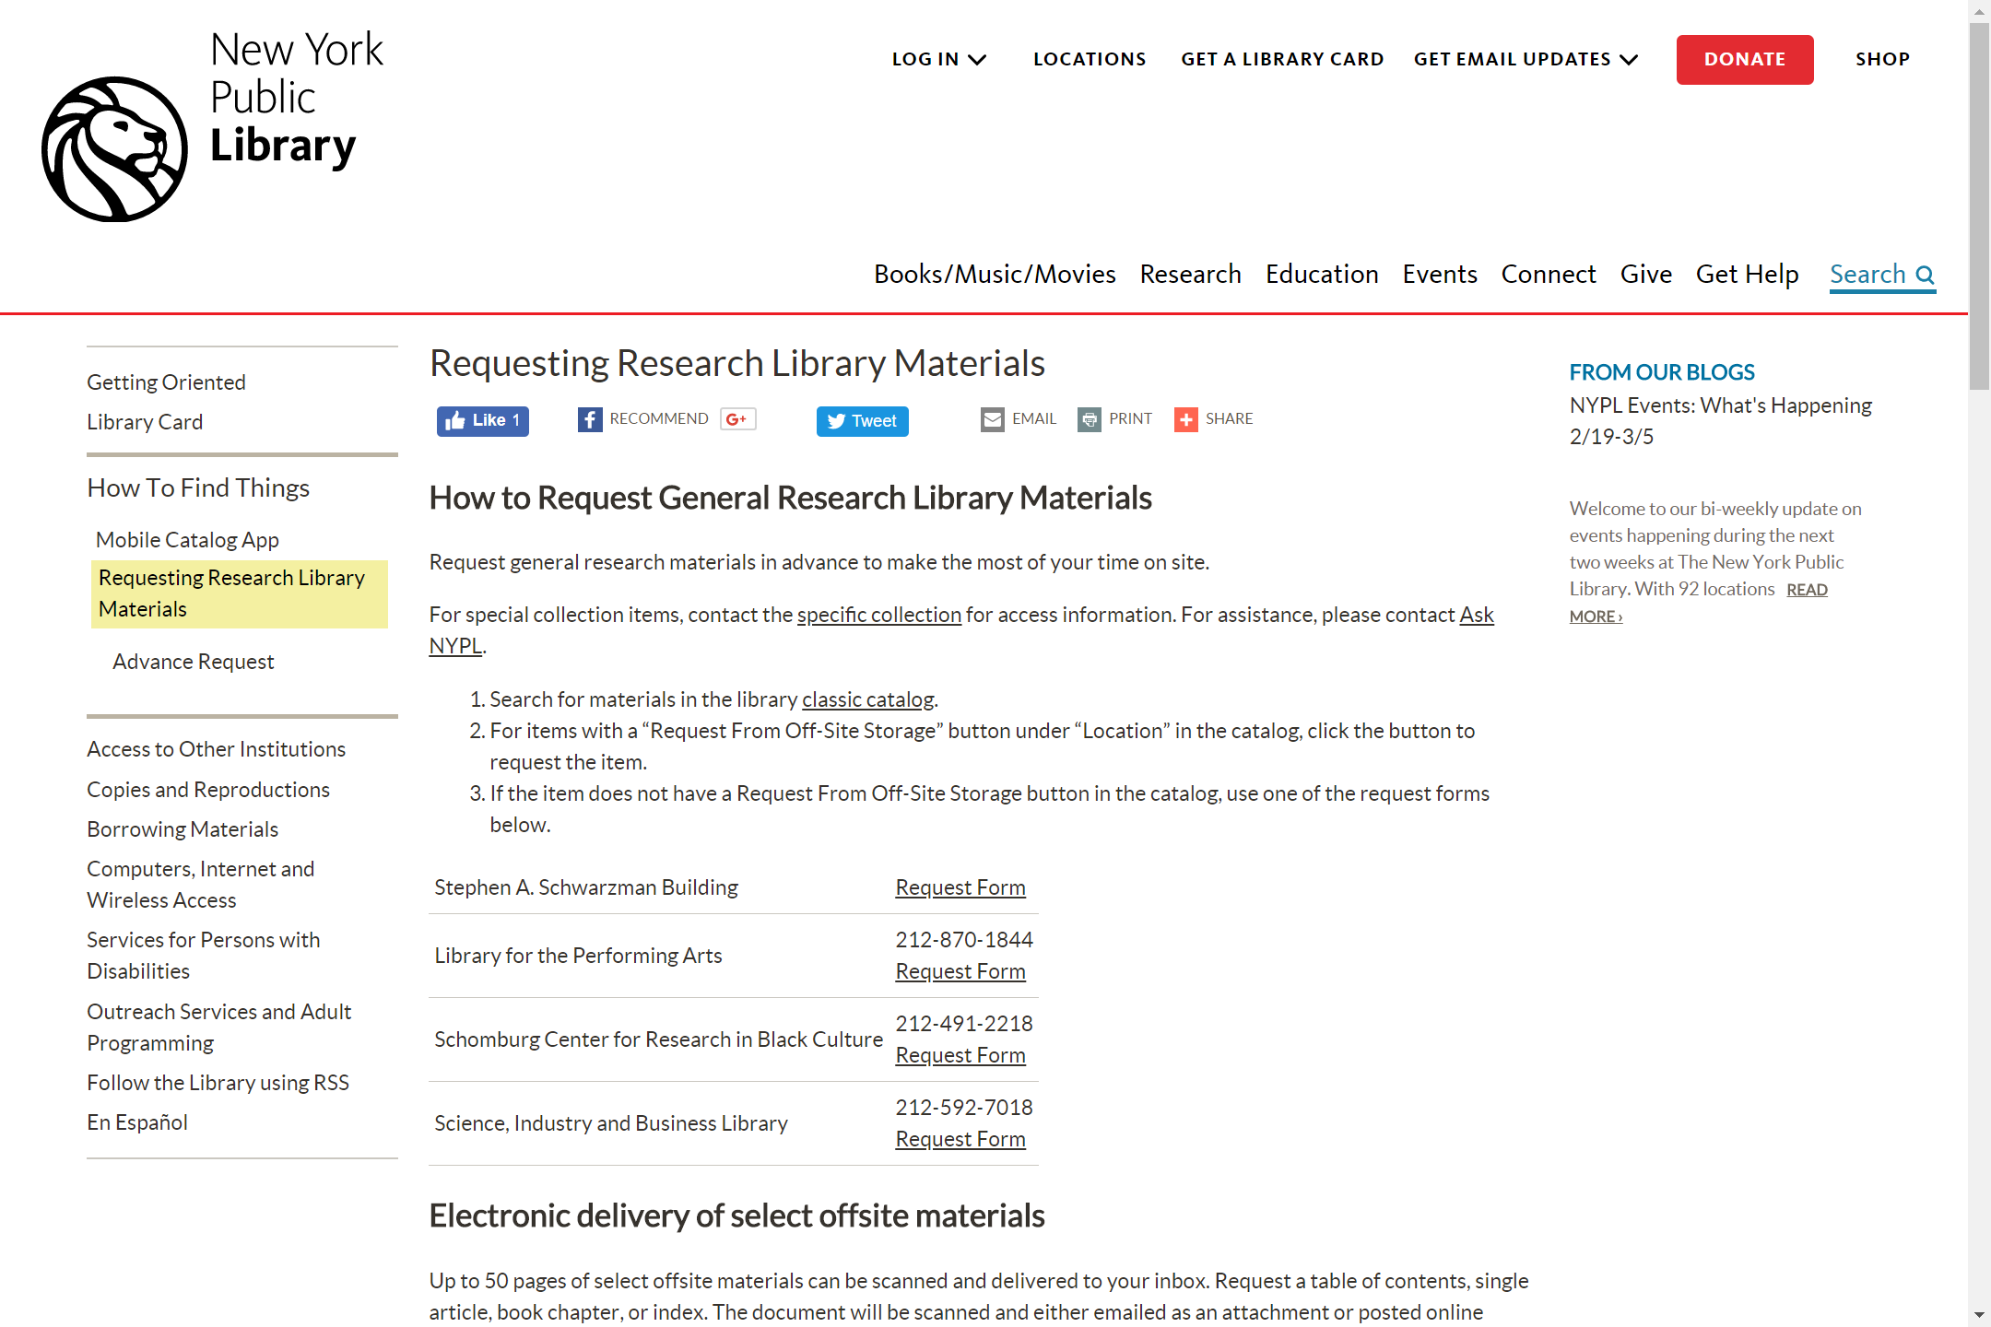
Looks at this for getting physical documents; clicked on request material on previous page

Slide 12
Archives portal

Slide 13
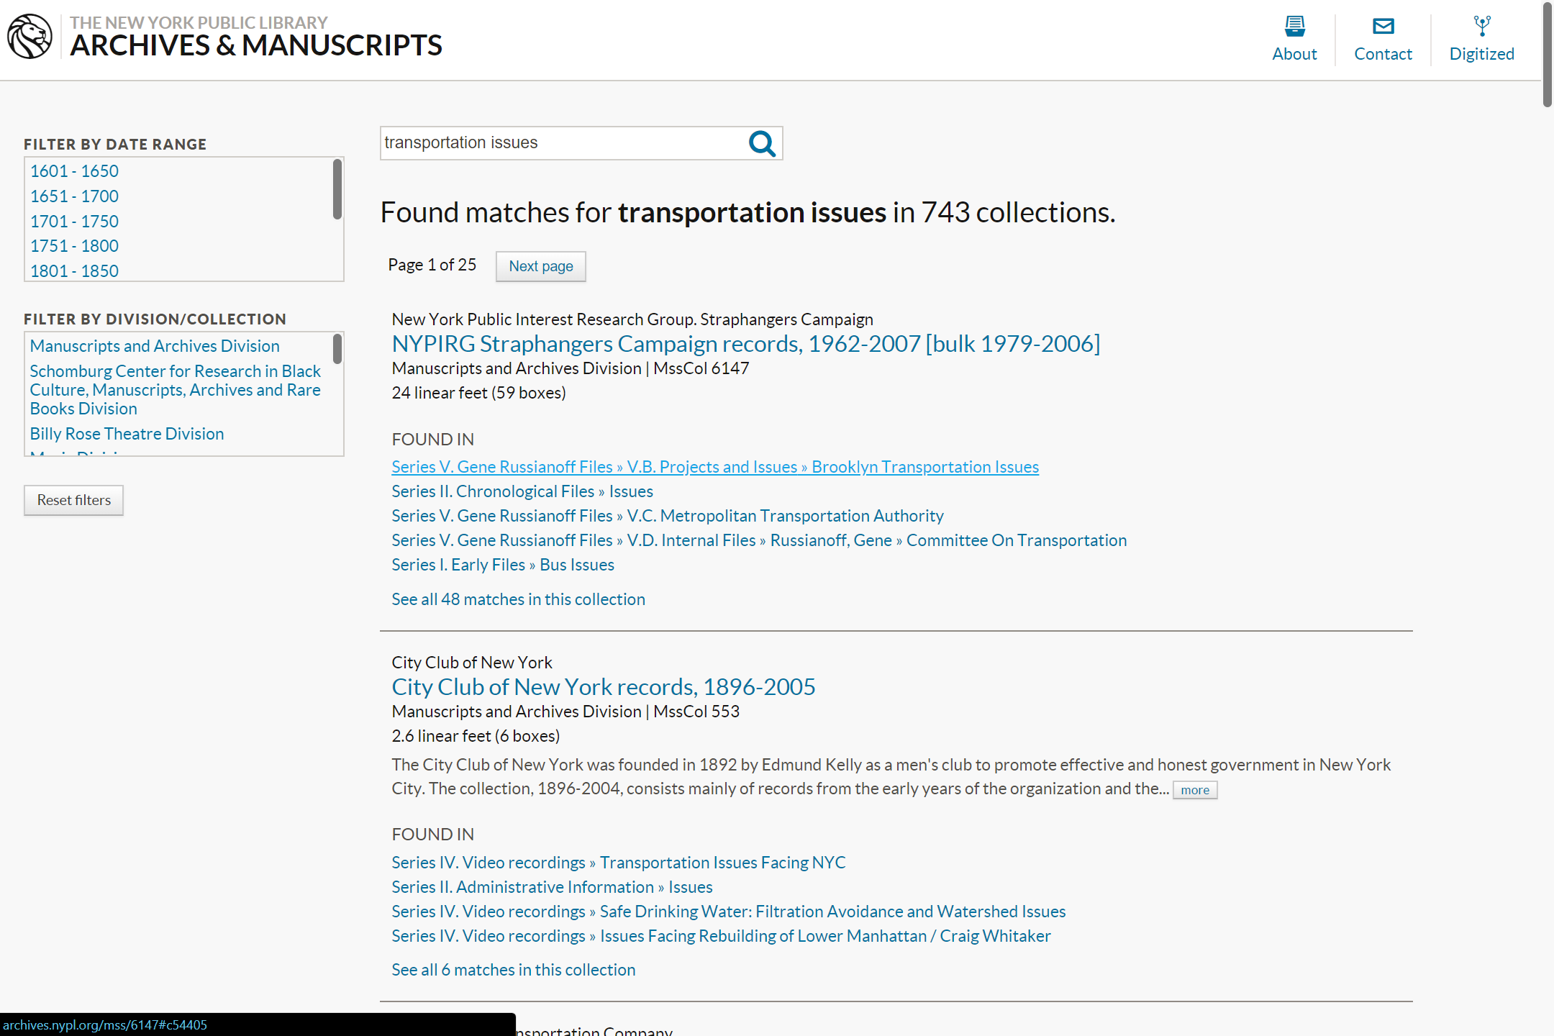
Search results; sees filters but doesn’t know what are in each division/collection so doesn’t use
Clicks on first resource

Slide 14
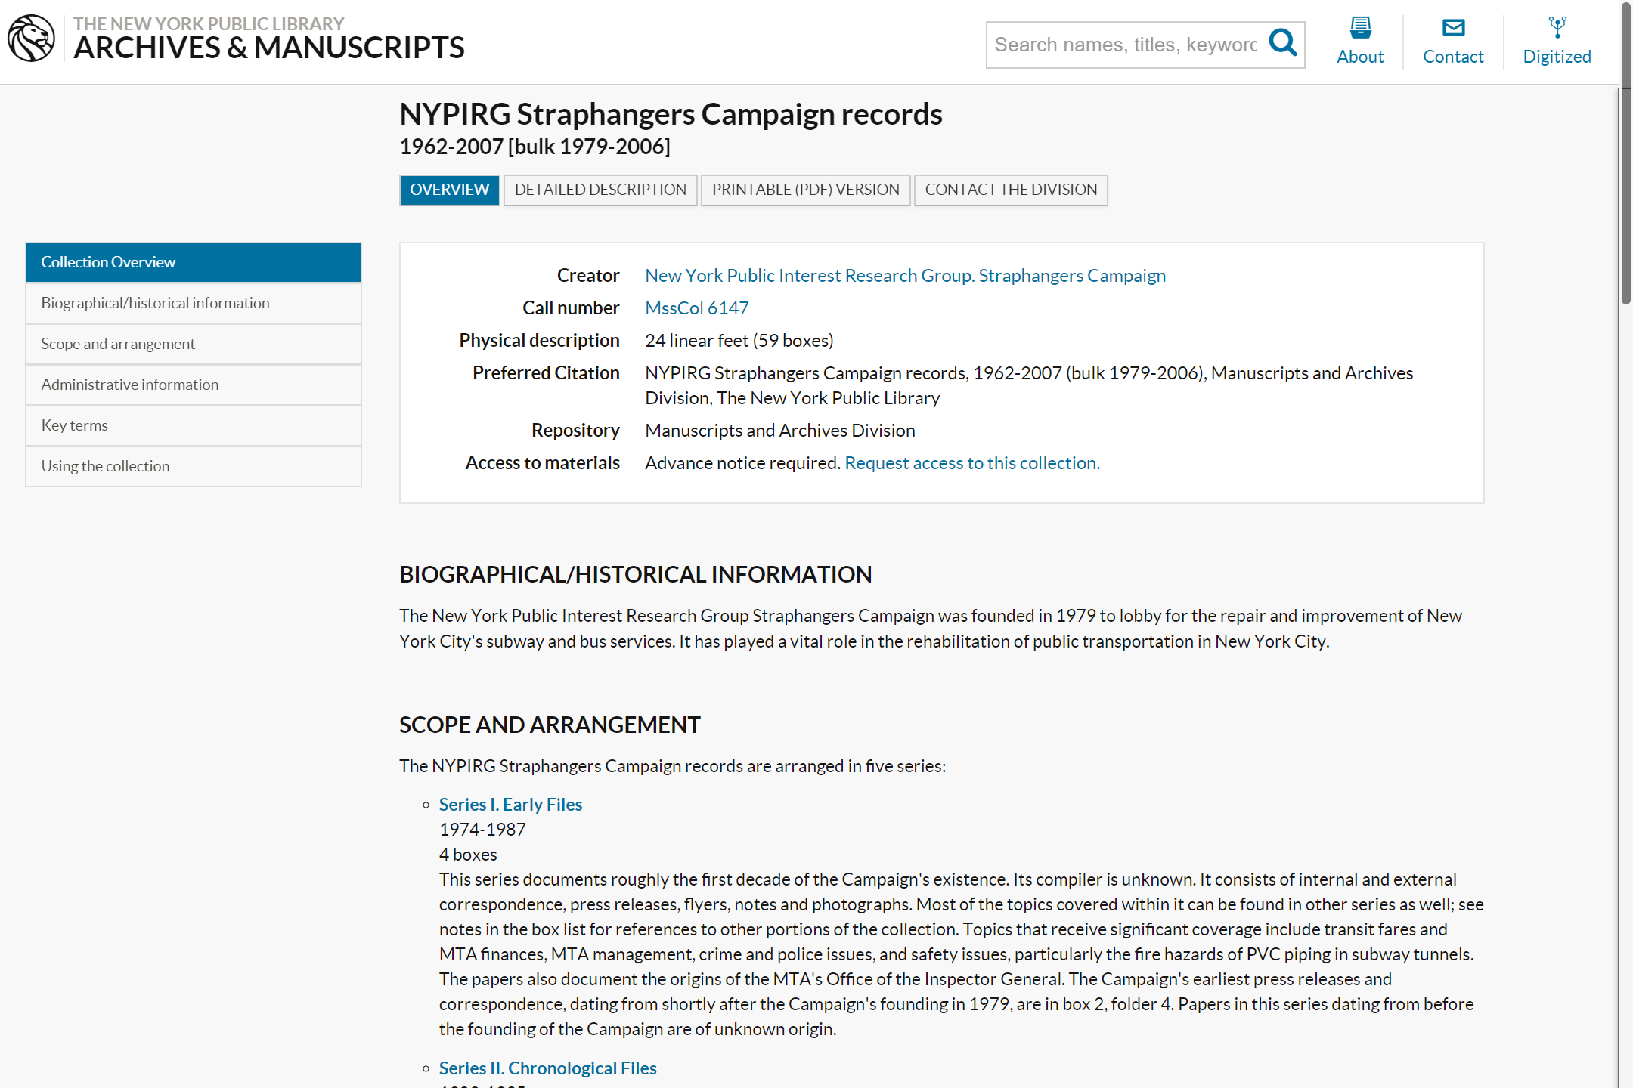
Clocks on using the collection/download

Slide 15
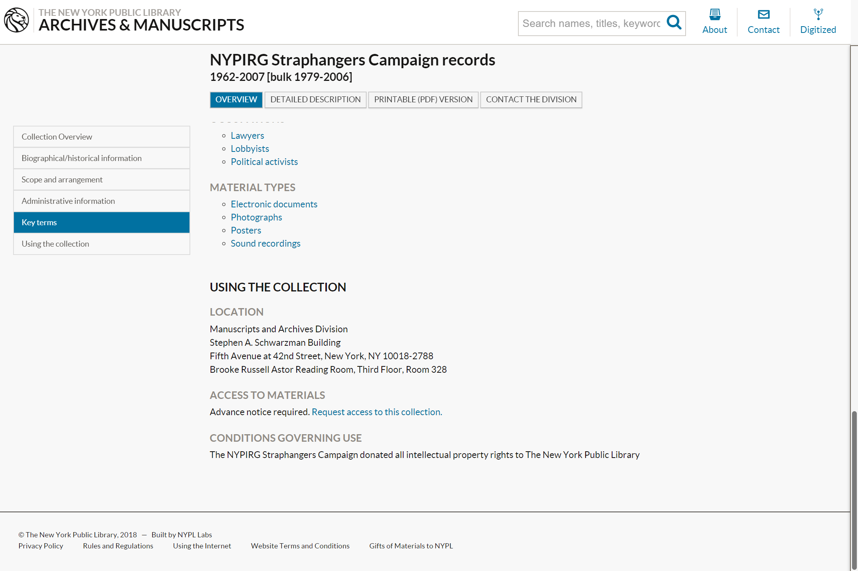
Does not notice the “advance notice required” for the resource if I want the physical copy

Slide 16

PDF document that I can download and access, 44 pages no preview of download

Slide 17
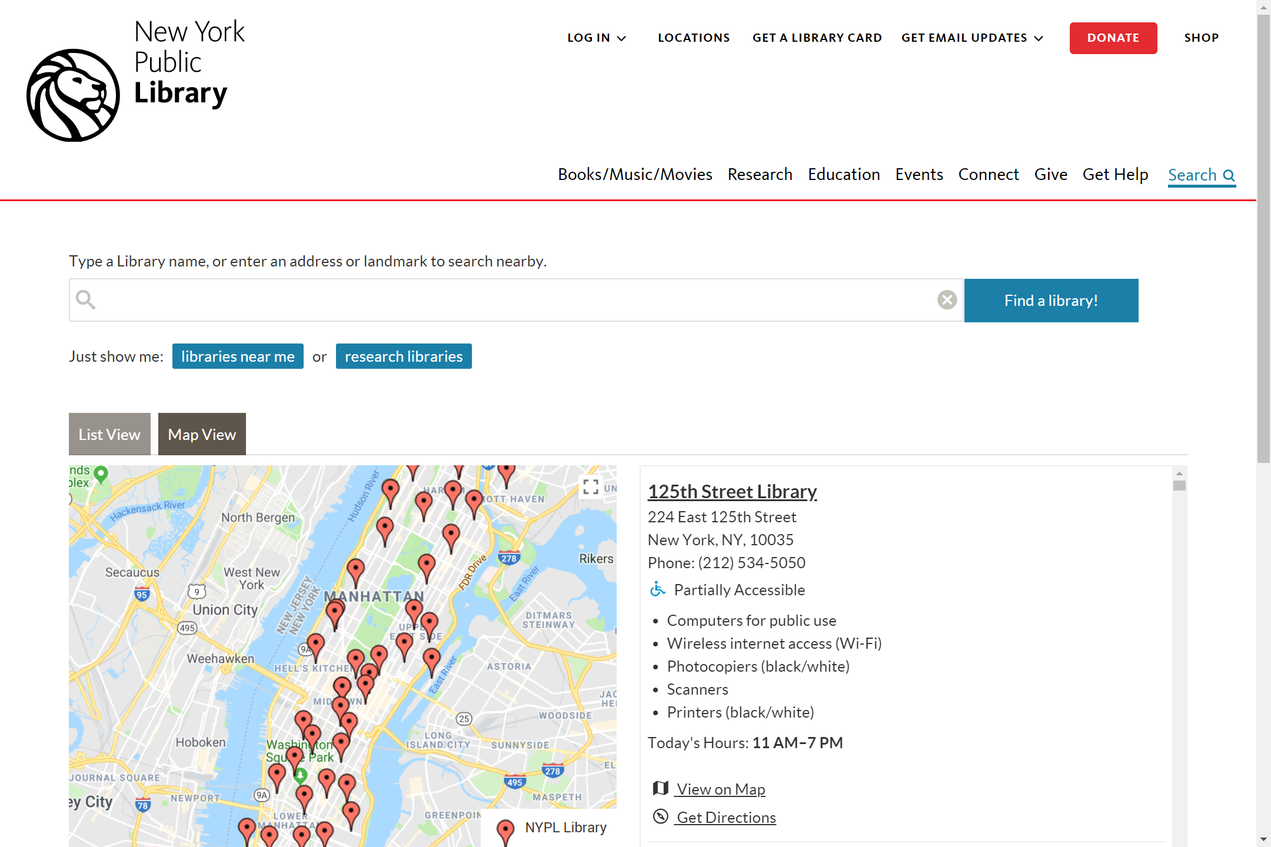
If I wanted to know the locations and hours for some reason
Clicking on name brings me to another site with detailed info about the library and events there
Clicking on get directions brings me to GoogleMaps

Slide 18
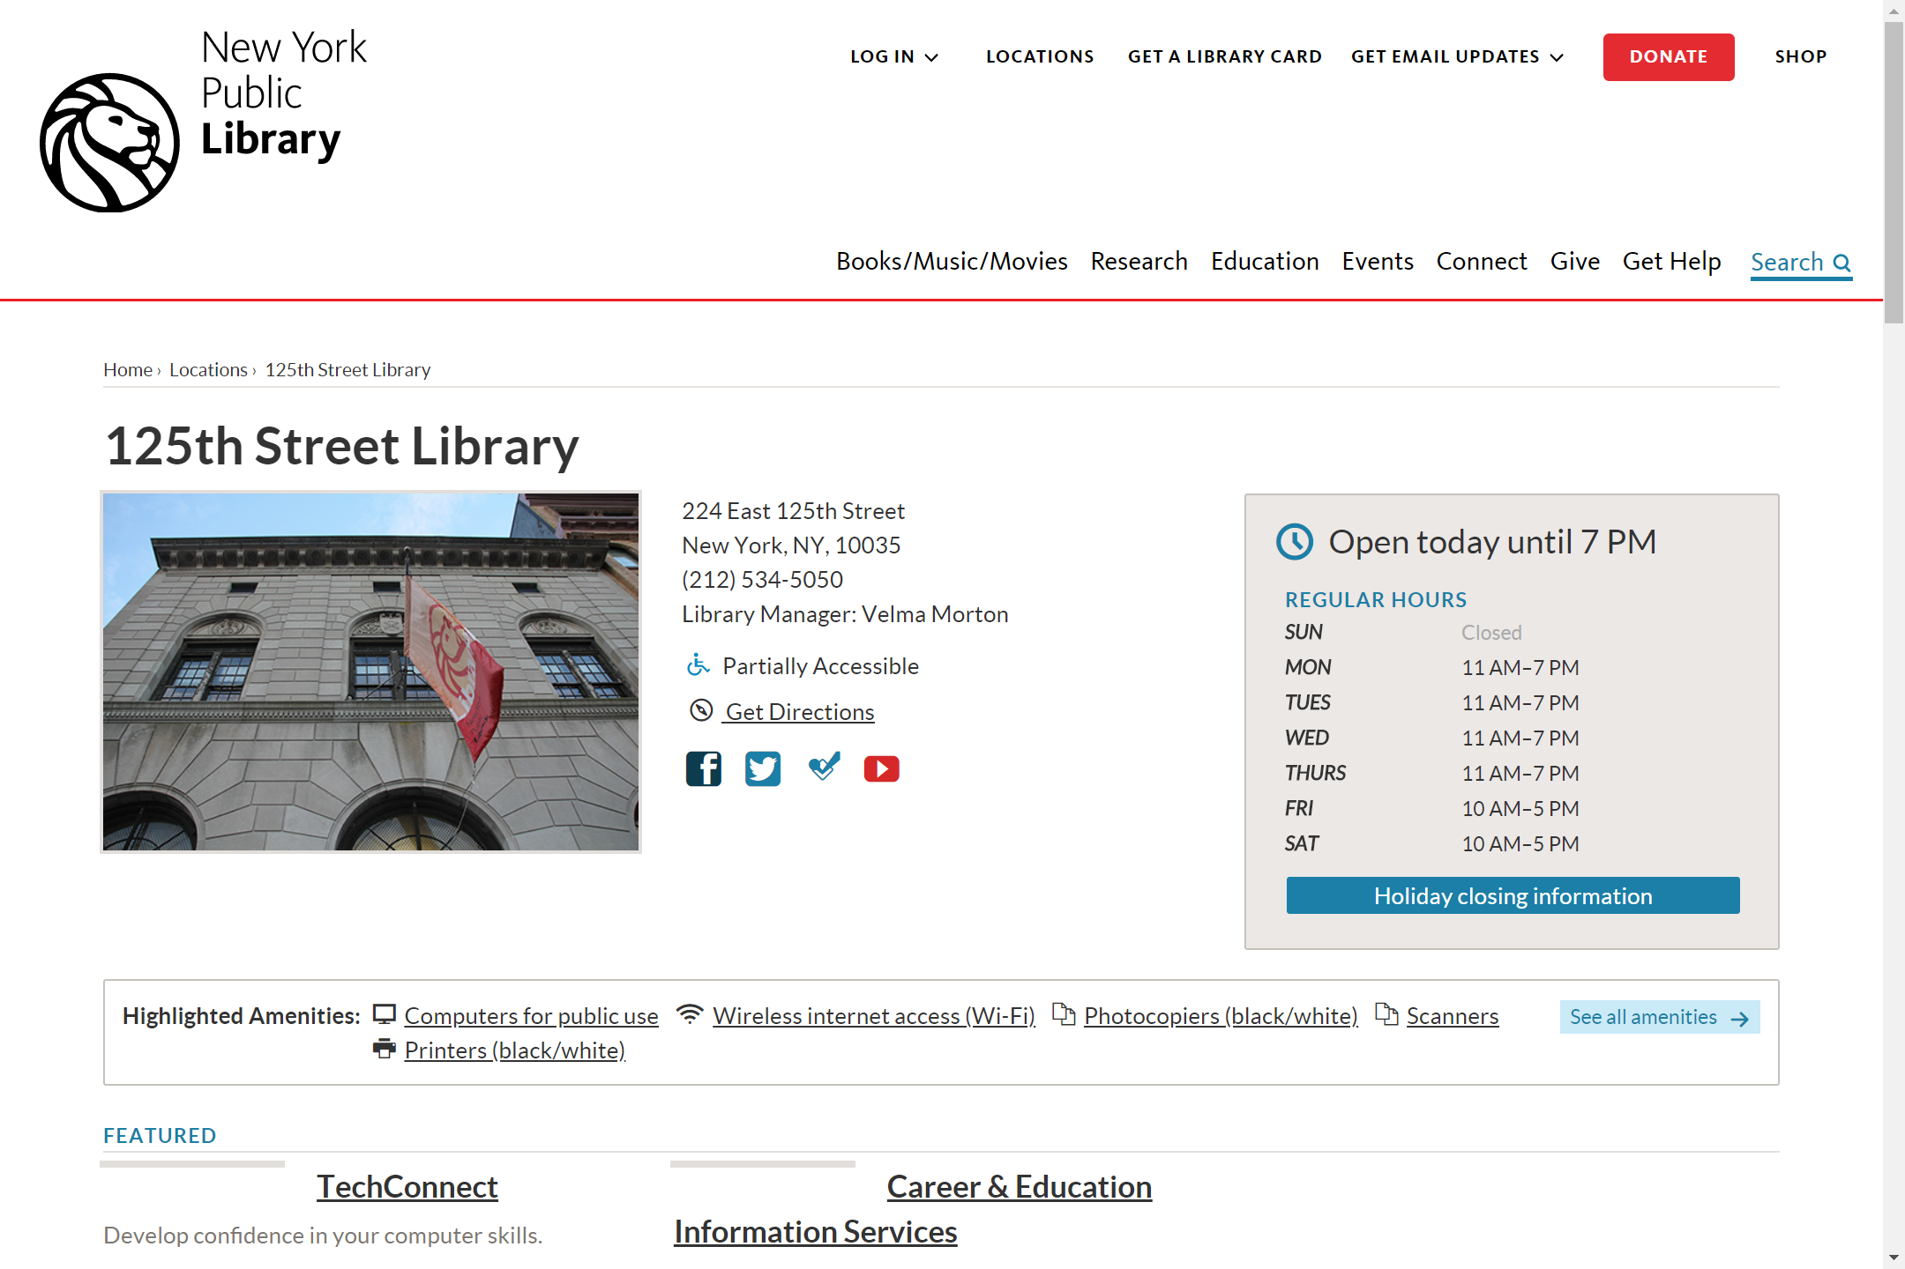
Info page about library of interest

Slide 19
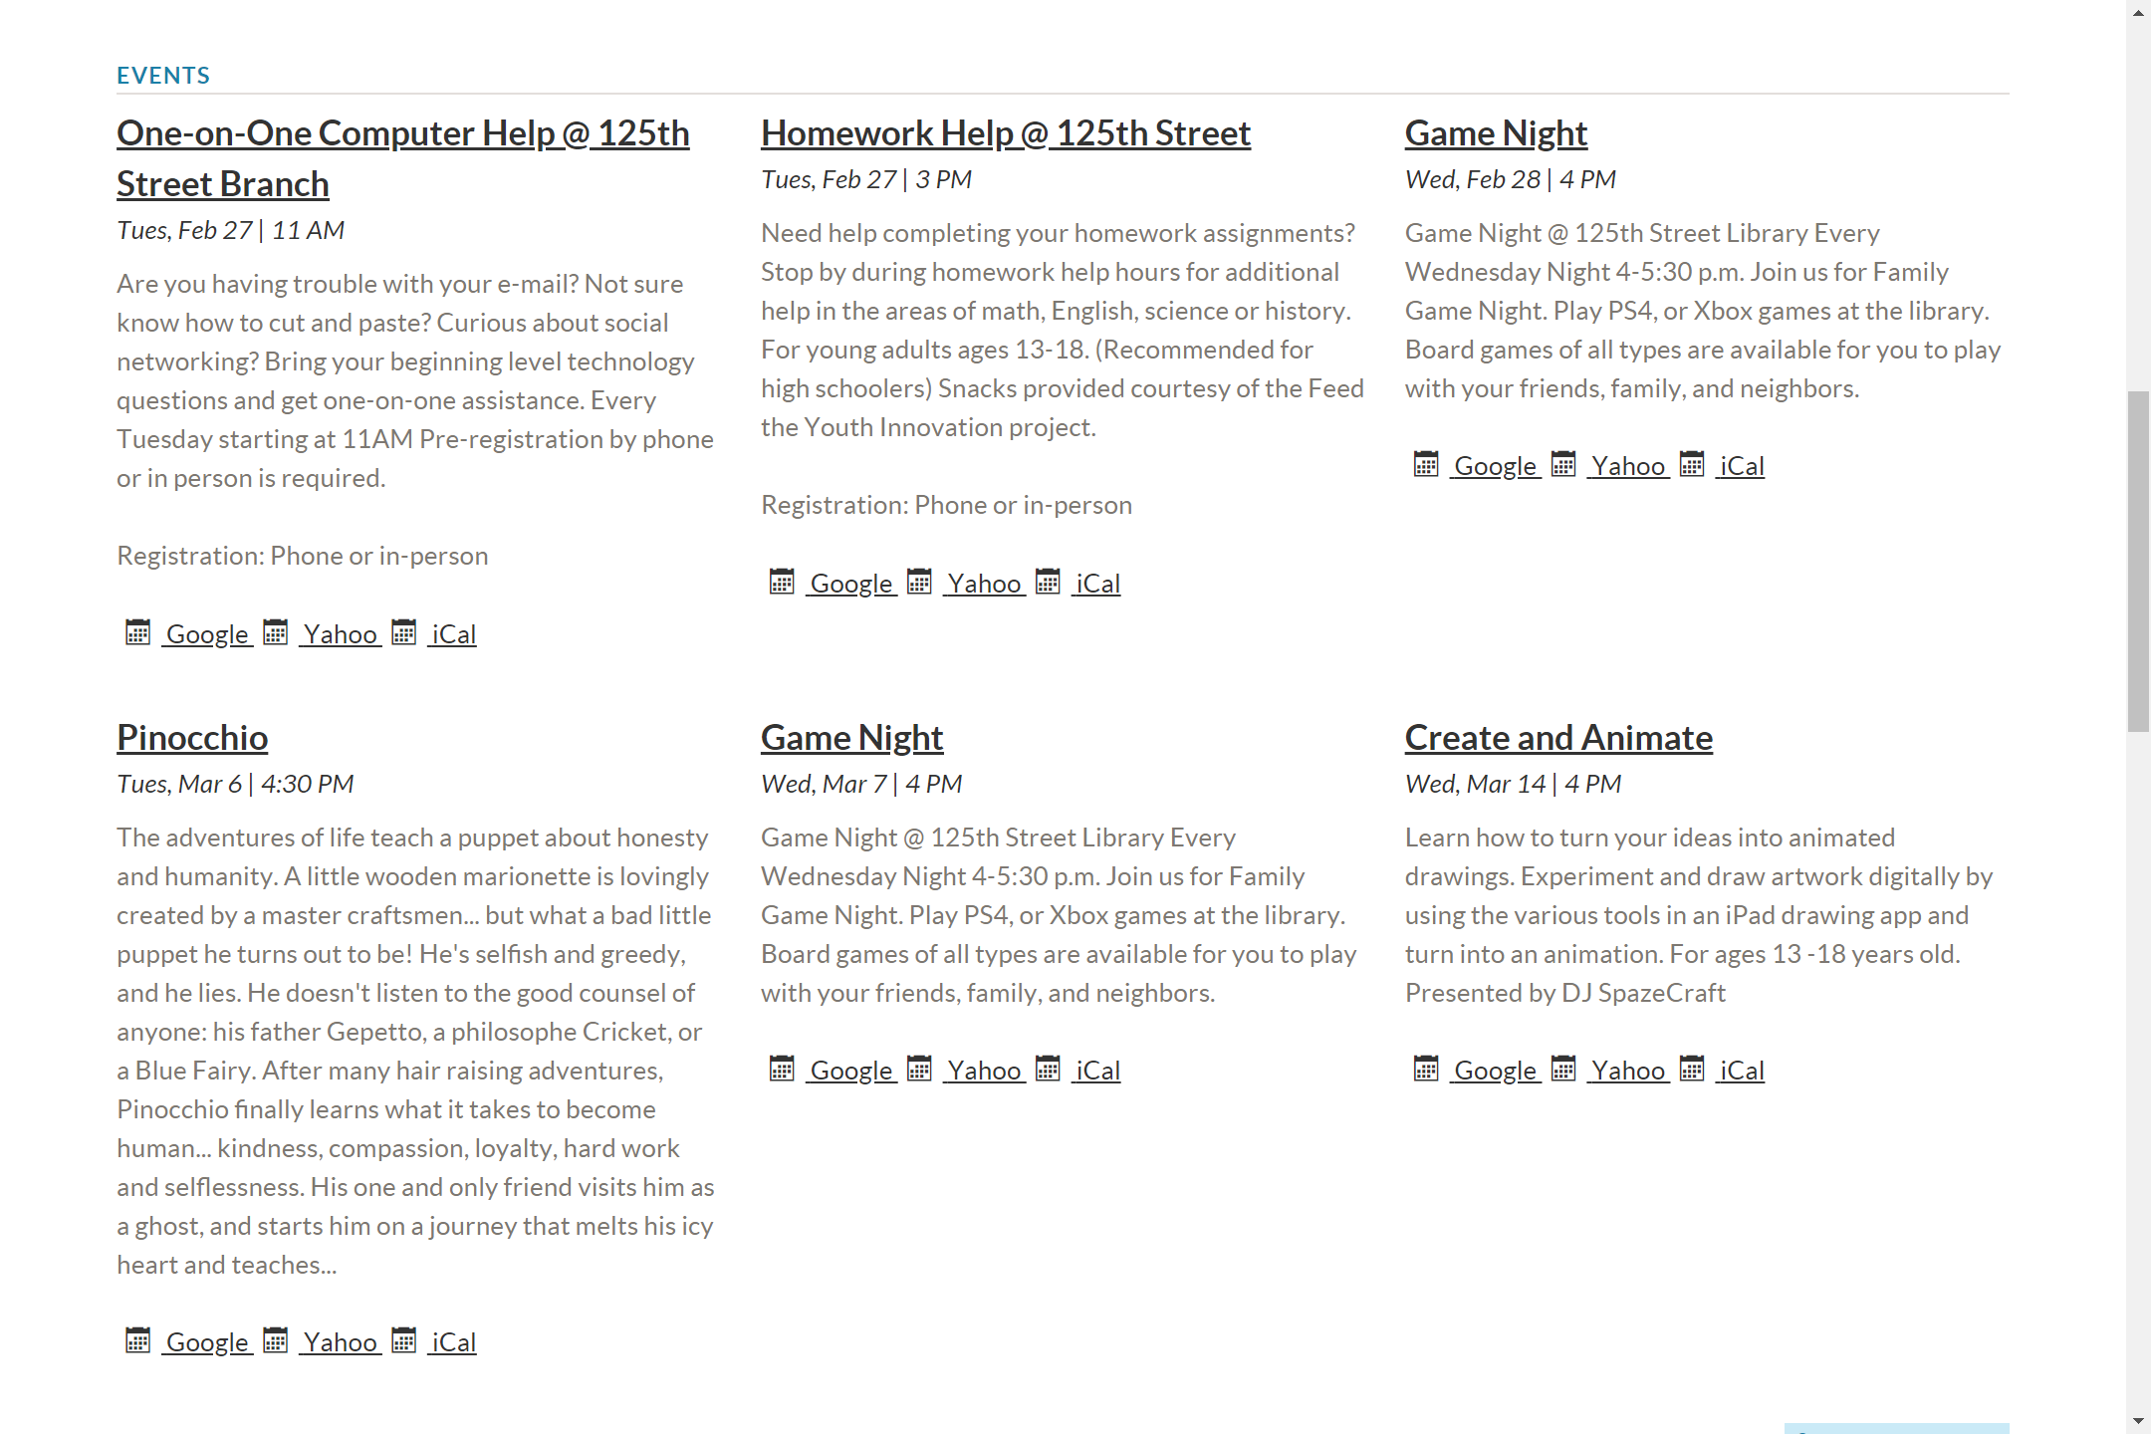
Events I won’t bother going to later down in the oage

Slide 20
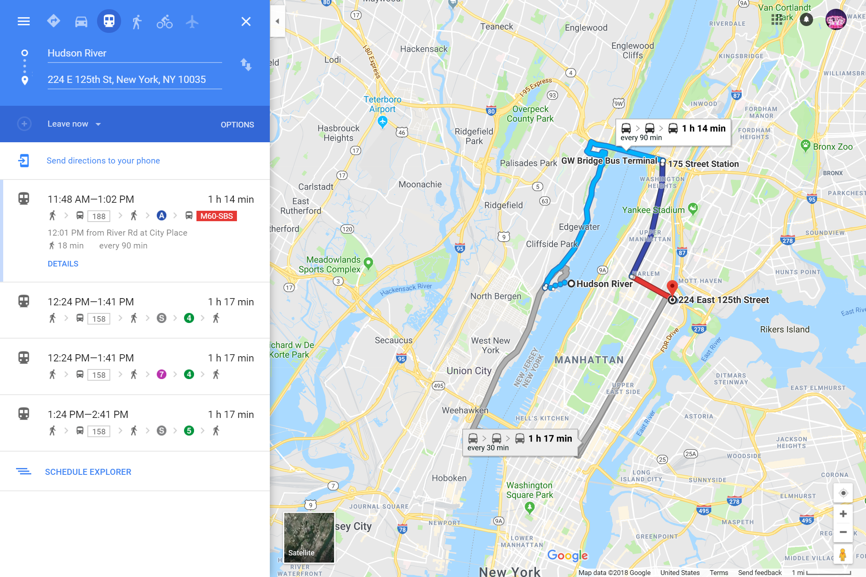
GoogleMaps of library location, chose bus

